Slide 1




WFER Session 3a
Energy transition, grid investments
and network tariffs
Luca Lo Schiavo
ERRA Research Unit
Tbilisi, session 3a 22 Sept.2026

Slide 2

ERRA as a shared platform for regulatory leadership
Report of Economic Regulation
and Electricity Markets Committee
DSO network tariff structure
A regulatory tool for future-proof power systems
17 ERRA countries actively participating
Coauthors:
  Lia Gvazava (GNERC Georgia), Coordinator
  Anastasija Stefanovska-Angelovski (ERC North Macedonia)
  Fatima Sifer Kacet (CREG Algeria)
  Suleman Yahya Alajlan and Hessa Alshunaybir (SERA Saudi Arabia)
  Luca Lo Schiavo and Mikheil Odisharia (ERRA Research Unit)
https://erranet.org/emer-com-report-dso-network-tariff-structure/
Notes:
The report's real value is turning individual country experience into common capital: every regulator, whatever their transition stage, has a concrete path forward — informed by peers who have already walked it.
Index: Exec Summ, Intro, 3 substance Chapters, Conclusions
8 final reccomendations

Slide 3
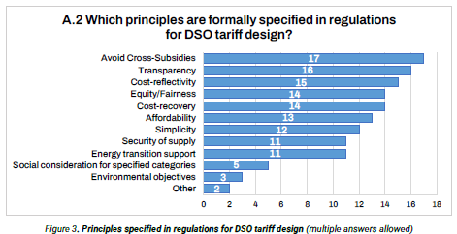
Principles formally specified in regulations for DSO tariff design
Common grounds below diversity
The survey shows how
much common ground ERRA regulators already stand on:
avoiding cross-subsidies
cost recovery
cost-reflectivity
transparency
equity/fairness
are written into regulation in nearly every member country.

Slide 4
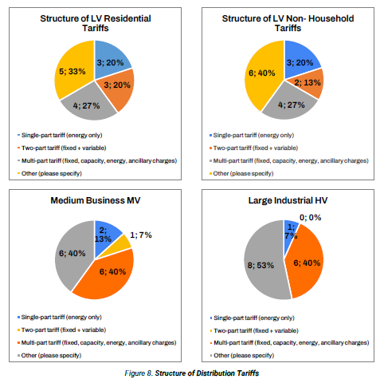
Structure of Distribution Tariffs /1
Moving beyond pure volumetric recovery
Most ERRA regulators already introduced capacity-based charges for MV/HV customers
The direction of travel
— away from pure volumetric recovery and toward cost-reflective, capacity-based charging — is already set and grounded also far Low-Voltage customers; what varies is the pace.

Slide 5
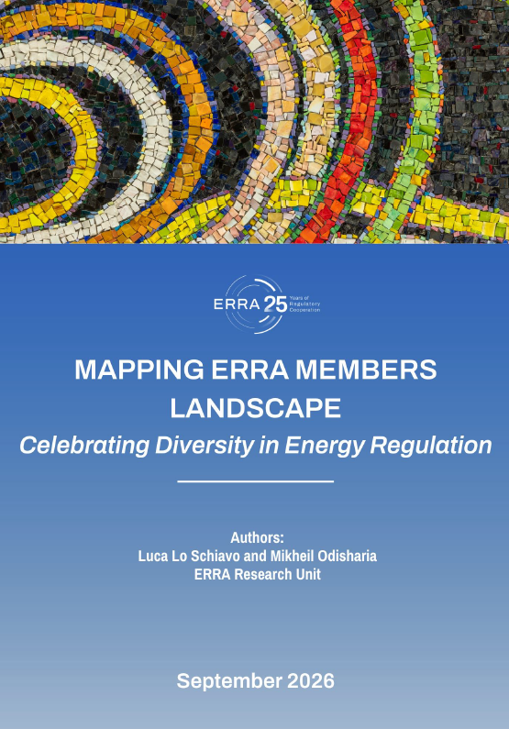
Structure of Distribution Tariffs /2
A confirmation from ERRA MAPPING Report
A large scale survey (37 regulators, of which 36 electricity regulators) on 13 different regulatory dimensions
How far from volumetric-only are electricity
distrib.network tariffs for household customers?
Group 0
unseparated
Group 1
100% volum
Group 2
<20% fixed
Group 3
20-50%
Group 4
>50% fixed
N=3
N=15
N=11
N=4
N=2
https://erranet.org/research-papers/

Slide 6
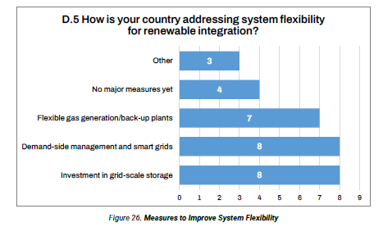
System Flexibility and Tariff Design
Investment in grid-scale storage
equals DSM and smart grids among measures for RES integration
The next move is to use tariff
design as a tool for future-proof energy system:
time-of-use signals (not only
network tariff!)
solving double-charging
for storage
stimulating off-peak
EV charging at home

Slide 7
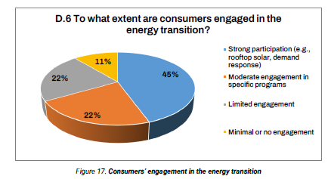
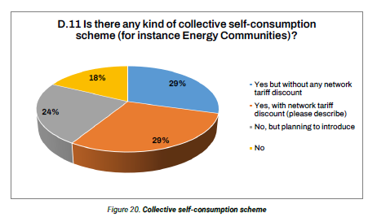
Self-consumption and
Energy Communities
High level of consumer engagement
in the energy transition
Self-consumption is already mainstream across ERRA countries.
The next step is consolidating clear, consistent rules on how shared consumption within energy communities is metered, billed and benefit-based discounted
ERRA is active in circulating best practices (Ankara workshop, Oct-25)
https://erranet.org/erra-workshop-energy-communities/

Slide 8
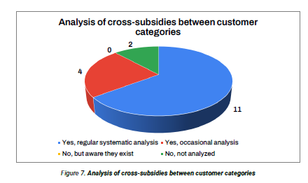
Analysis of cross-subsidies between customer categories
Full public disclosure makes explicit
the subsidy policy rationale
A mark of regulatory practice: the large majority of ERRA regulators actively and systematically track
cross-subsidies between customer categories

Slide 9
DSO network tariff structure
A report from ERRA, and more
luca.loschiavo@erranet.org

